Slide 1

Smart Crop Yield Prediction: Leveraging Machine Learning and Big Data for Sustainable Agriculture
Group 3
Team Members:
Srisai Kumar Resu (11744462)
Jignesh Nallamala (11751697)
Sreyesh Varma Konduru (11809300)
Greeshma Mandala (11860371)
Mrudula Mende (11754413)
CSCE 5300: Introduction to Big Data and Data Science

Slide 2
Motivation
Agriculture is vulnerable to unpredictable factors such as weather, soil, and water availability.
Farmers lack real-time tools to predict yield accurately.
Our model uses Big Data and ML to provide early predictions and support decision-making.
Rising population demands more precise food production.
Traditional methods lack predictive accuracy in modern environments.

Slide 3
Significance
Supports sustainable agriculture with data-driven insights.
Predictive models help optimize resource use and prevent crop failures.
Useful for policy-makers, agritech companies, and farmers.
Helps reduce crop failure risks due to unpredictable weather.
Provides a scientific base for agricultural decision-making.

Slide 4
Objectives and Goals
Develop a predictive model to estimate crop yield.
1
Preprocess, visualize, and model using ML techniques.
3
Evaluate models and integrate historical climate data.
4
Validate results against historical production records.
5
Prepare the model for scalable deployment across other crops/region
6
Collect multi-source agricultural and environmental data.
2

Slide 5
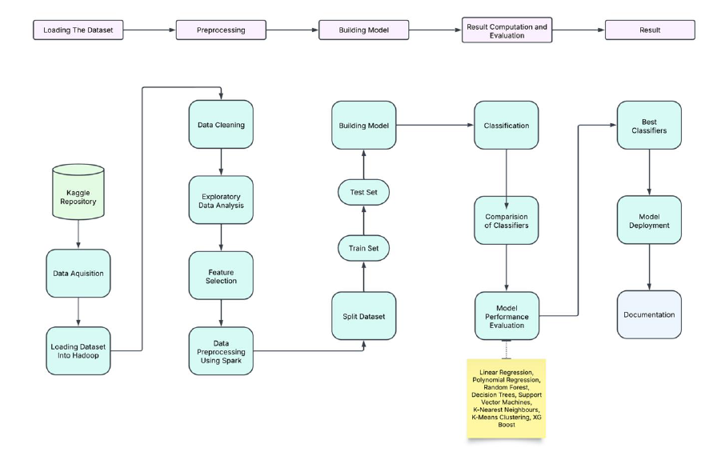
Workflow Diagram

Slide 6
Frameworks and Tools
Pandas, NumPy – Data handling and transformation.
Matplotlib, Seaborn – Visualization.
Scikit-learn – ML algorithms (SVR, RF, etc.).
PySpark – Scalable data transformation pipeline.
World Bank Portal – Climate data integration.
Jupyter Notebook used for iterative model development.
Excel and CSV for intermediate data inspection and merging.

Slide 7
Dataset
Crop statistics from Kaggle: Area, Production, State, Crop.
Soil classification and rainfall/temperature added.
Merged, cleaned, and prepared into 36 features.
Used for training regression-based yield prediction models.
Additional soil features: Red, Black, Alluvial encoded as binary flags.
Region-wise aggregation helped in pattern identification.

Slide 8
Dataset
The dataset contains the following features with detailed descriptions:
• Crop Name: Type of crop grown (e.g., Rice, Wheat, Cotton).
• Season: Time of year when the crop was grown (Kharif, Rabi, etc.).
• State: Indian state where the crop was cultivated.
• Area of Cultivation: Total land area used for growing the crop (in hectares).
• Crop Production: Amount of yield produced (in metric tons).
• Rainfall: Average rainfall during the crop's growing period (in mm).
• Fertilizer Usage: Amount of fertilizer applied (in kg/hectare).
• Soil Types: Presence of Red, Black, Alluvial, or Laterite soil (binary flags).
• Average Temperature: Monthly average temperature during the growing season (in °C).
• Year of Cultivation: The year in which the crop was cultivated.

Slide 9
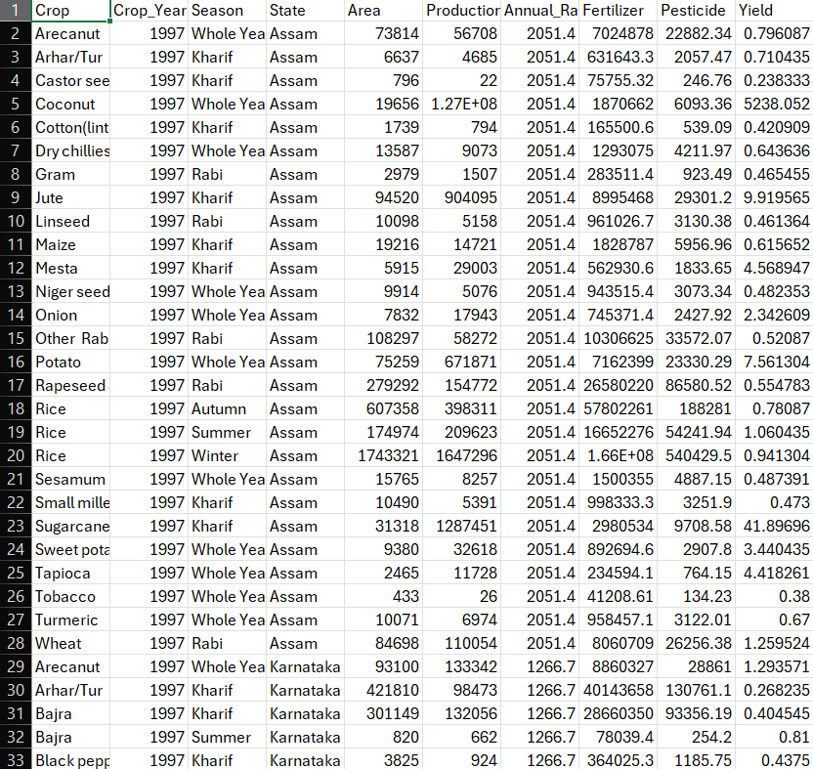
Screenshot of Dataset

Slide 10
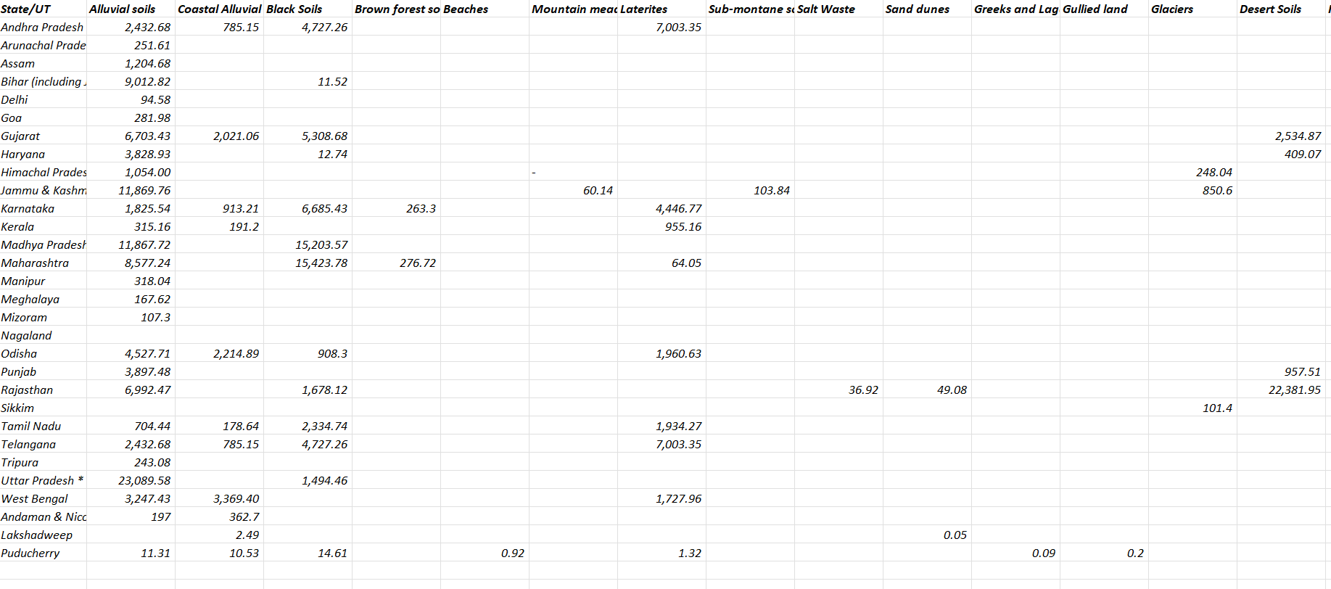

Slide 11
Data Preprocessing
Filled missing values, removed noise.
Categorical encoding (State, Season, Crop).
Scaling using StandardScaler.
Log transform applied to skewed columns.
Final DataFrame split into train/test sets.
Data normalized to prevent bias due to large value differences.
Irrelevant or sparse features were dropped to improve model generalization.

Slide 12
Data Processing Techniques
Data Collection: Crop, soil, and climate data from Kaggle, Excel, and World Bank.
Data Integration: Merge datasets using common keys like State and Year.
Null Handling: Impute or drop missing values.
Encoding: Transform categorical variables into numeric format.
Outlier Removal: Detect and fix extreme values.
Scaling: Normalize numerical features.
Feature Vector Assembly: Combine cleaned features.
Train-Test Split: Prepare for model training and evaluation.

Slide 13
Implementation
Bigdata tools such as spark are used in this project to store and preprocess the data of crop yield.
After reading the bigdata, we have implemented pre-processing techniques like log transformation for skewed data, One-hot encoding and even feature scaling.
Later EDA(Exploratory data analysis) is performed on the data and got the correlation matrix and other relations between different entities.
We have created various machine learning models which might be relevant for our dataset and trained the models.
Finally compared each ML model to find the model with the best accuracy.

Slide 14
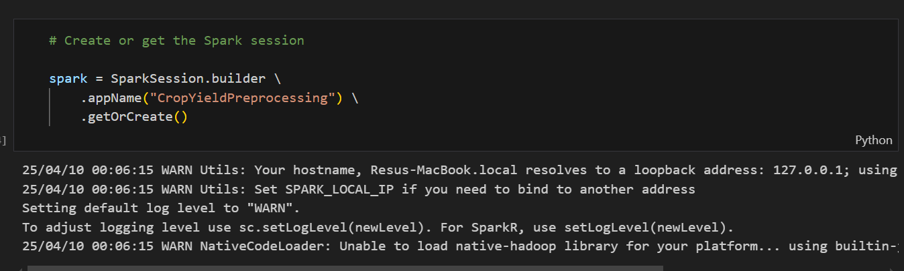
Used spark to store the dataset for easy acess

Slide 15
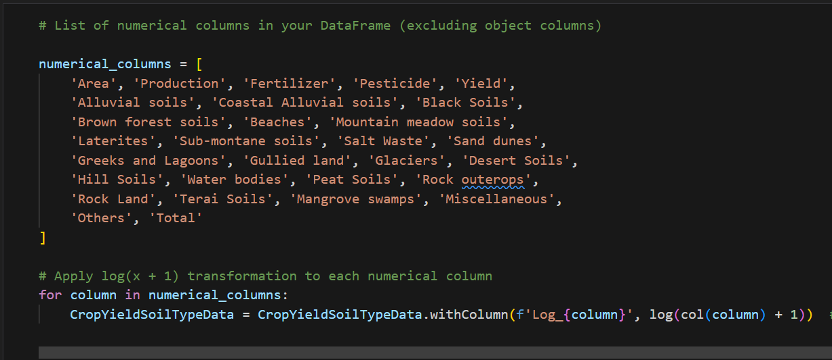
Implemented Log transformation for Skewed Numerical Data
Preprocessing data

Slide 16
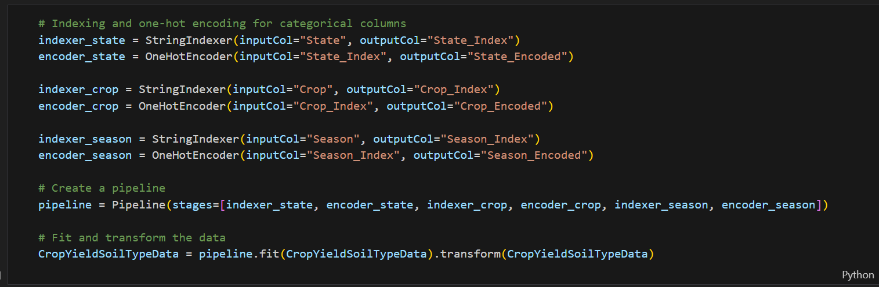
Used One-Hot Encoding to convert the categories in Dataset into numerical data

Slide 17
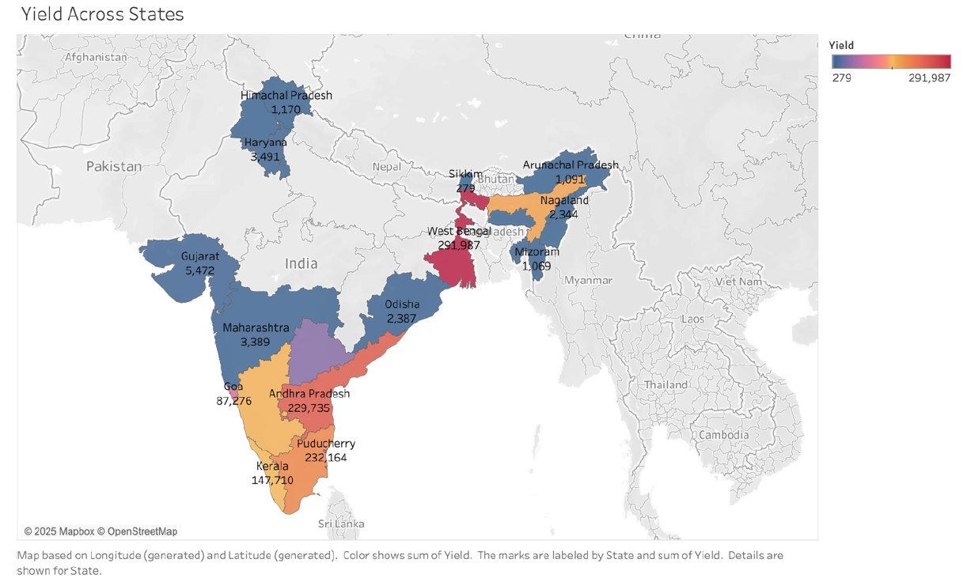
Exploratory Data Analysis
Distinguished the crop yield across different states in India
Output:

Slide 18
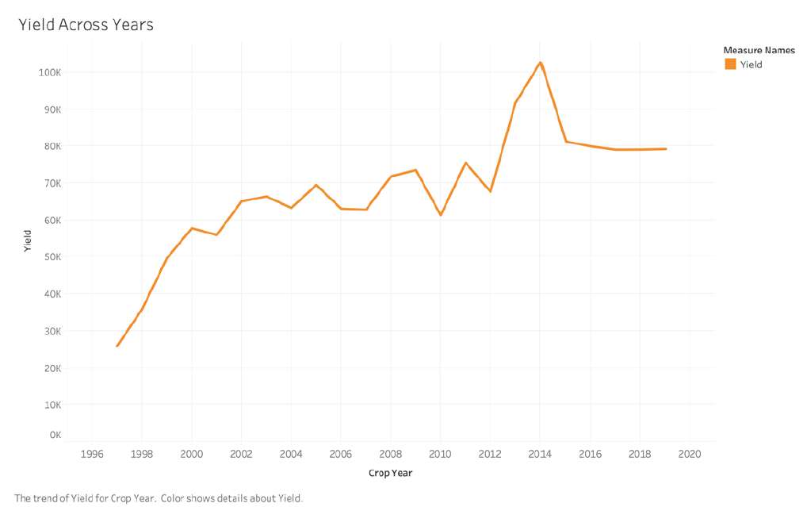
Exploratory Data Analysis
This graph show the crop yield across years from 1997 to 2020
Output:

Slide 19
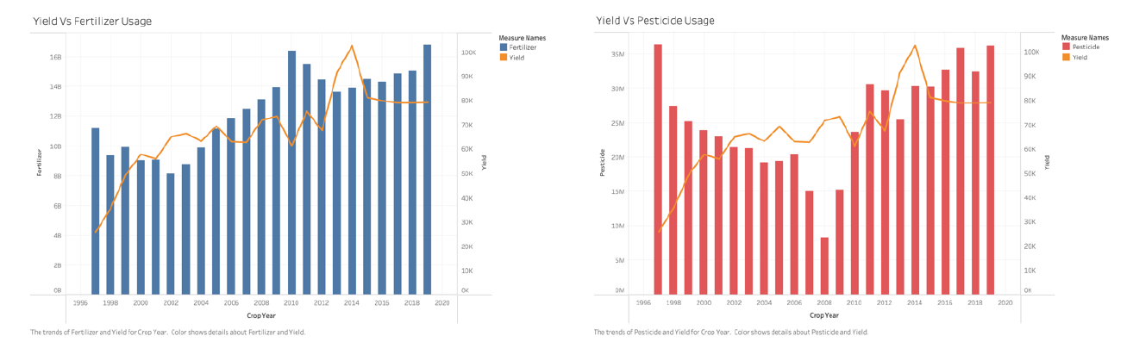
Exploratory Data Analysis
These two graphs show the difference between the crop yield by using Fertilizers and using pesticide on the crop. We can see that the yield from using Fertilizers was constantly increasing where as the yield from using peticides was not that stable
Output:

Slide 20
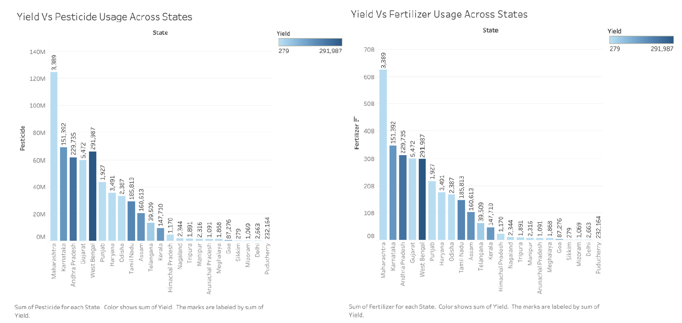
Exploratory Data Analysis
These two graphs show the difference between the crop yield by using Fertilizers and using pesticide in each different state in India. From these graphs we can see that Maharashtra state has the highest crop yield using both Fertilizers as well as Pesticides.
Output:

Slide 21
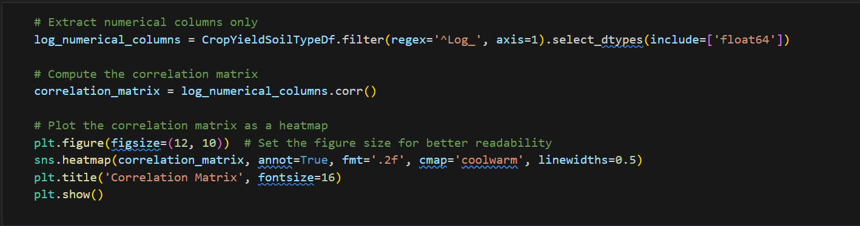
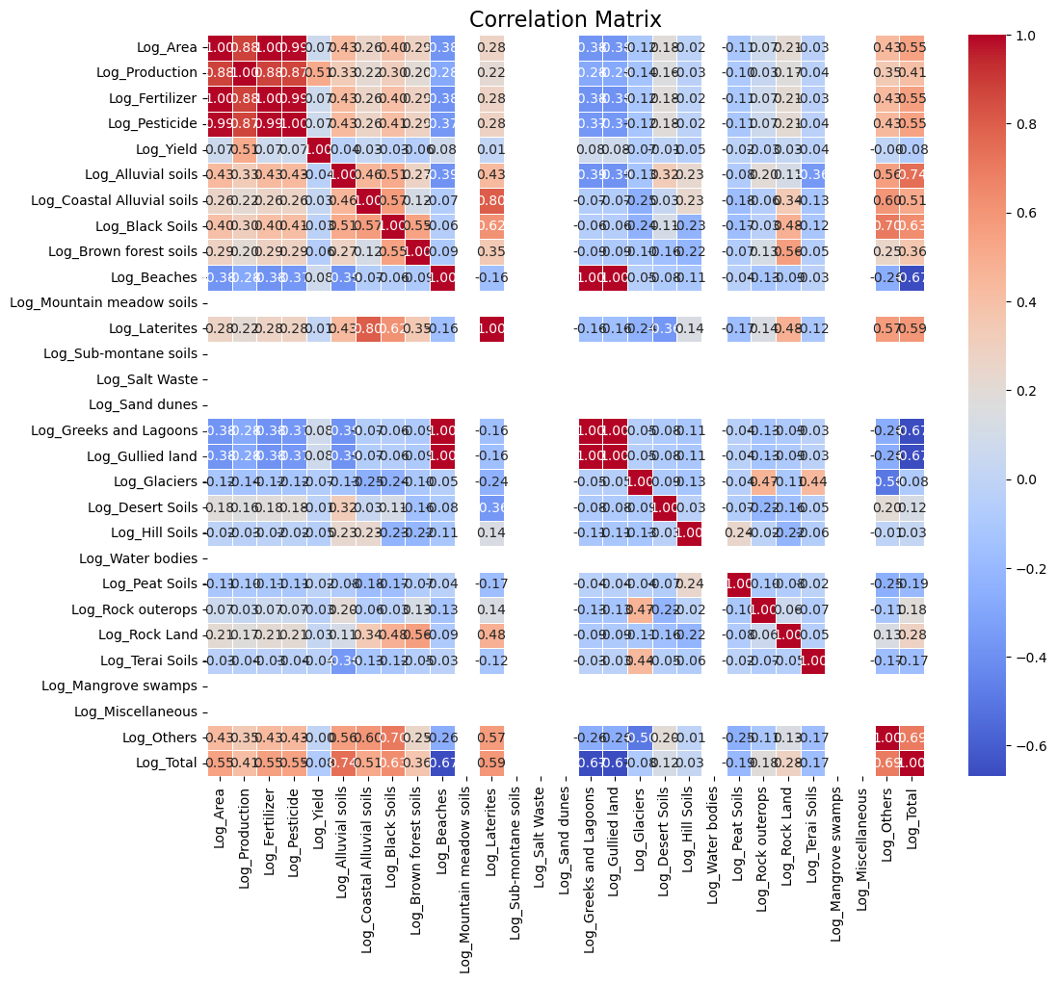
Exploratory Data Analysis
Started the EDA process with computing the correlation matrix for the data
Output:

Slide 22
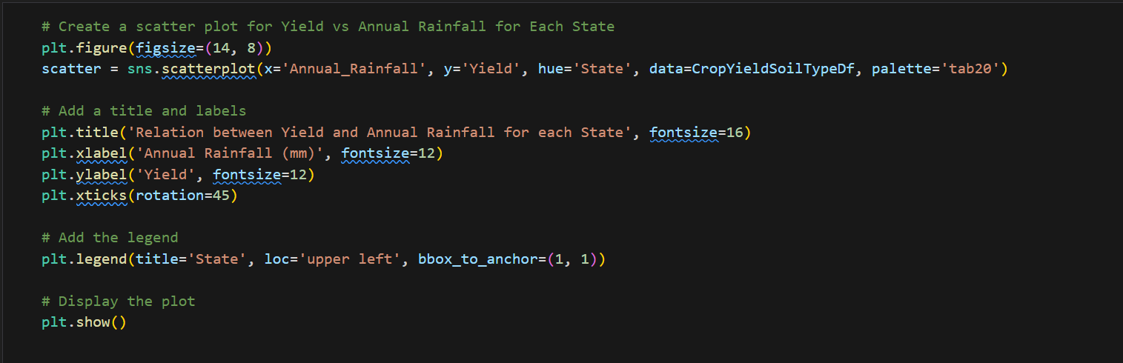
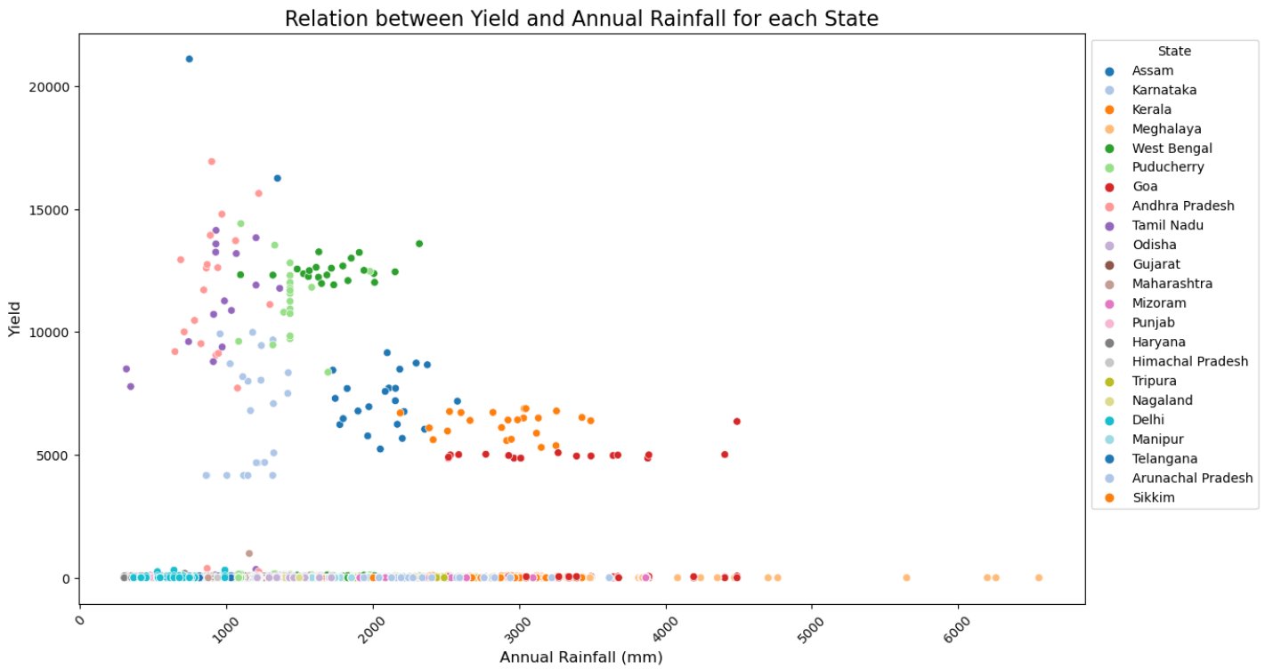
Exploratory Data Analysis
Found the relation between crop yield and annual rainfall for each state
Output:

Slide 23
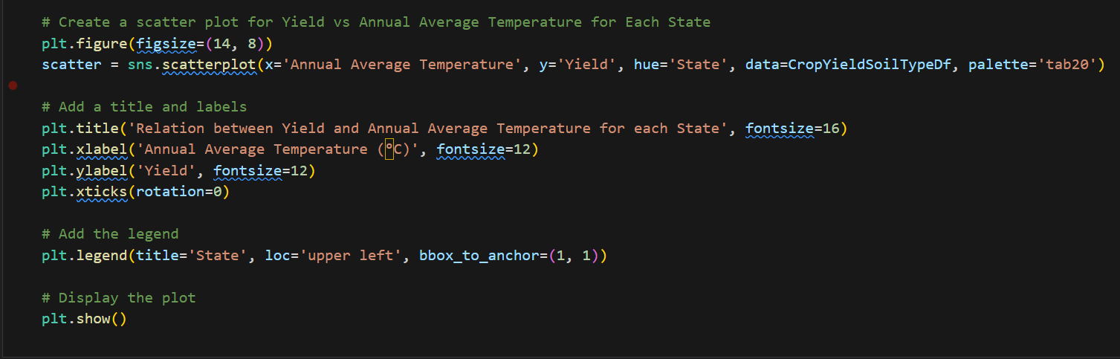
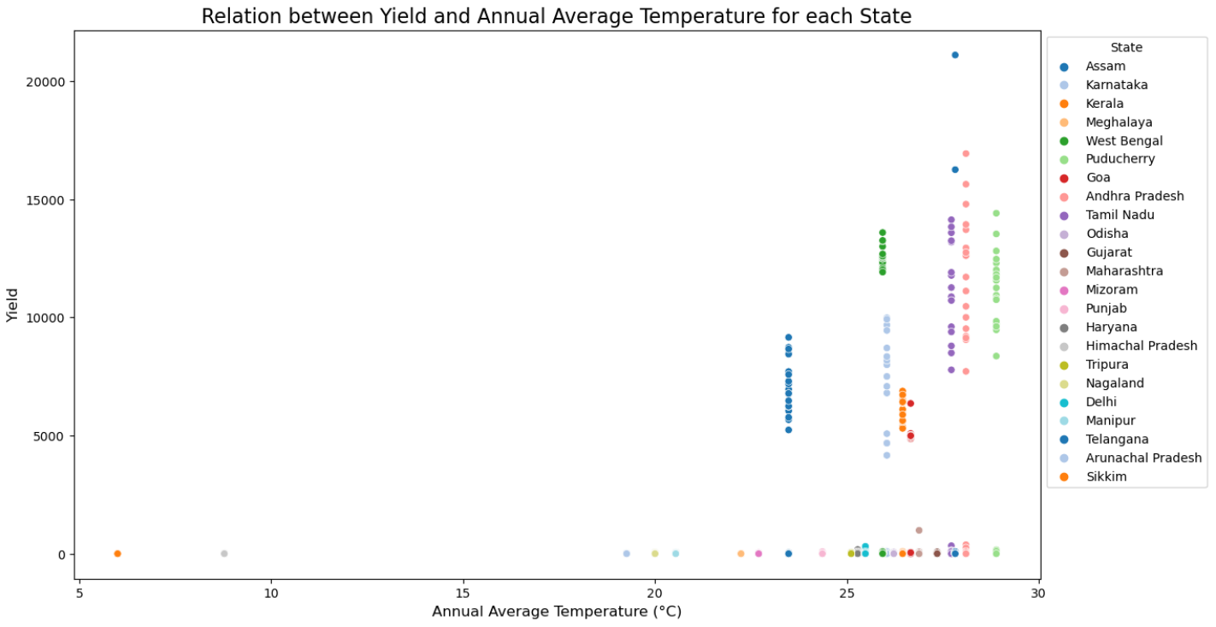
Exploratory Data Analysis
Found the relation between crop yield and average temperature for each state
Output:

Slide 24
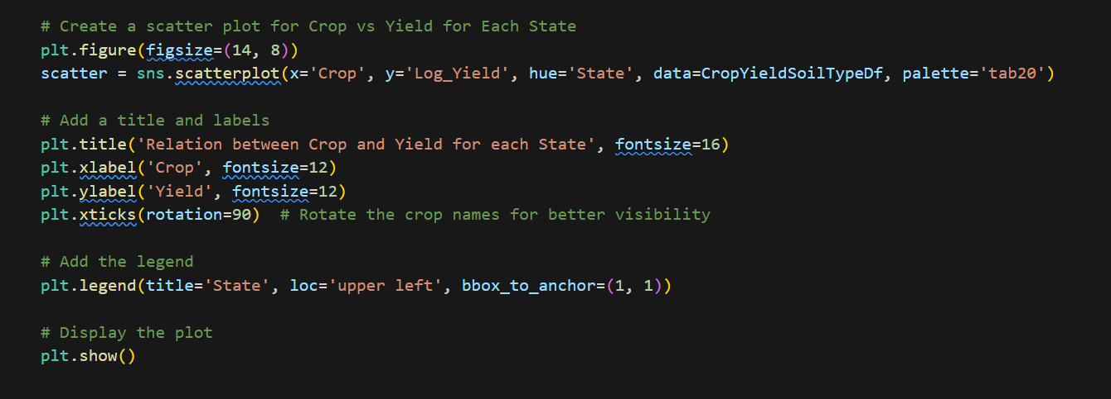
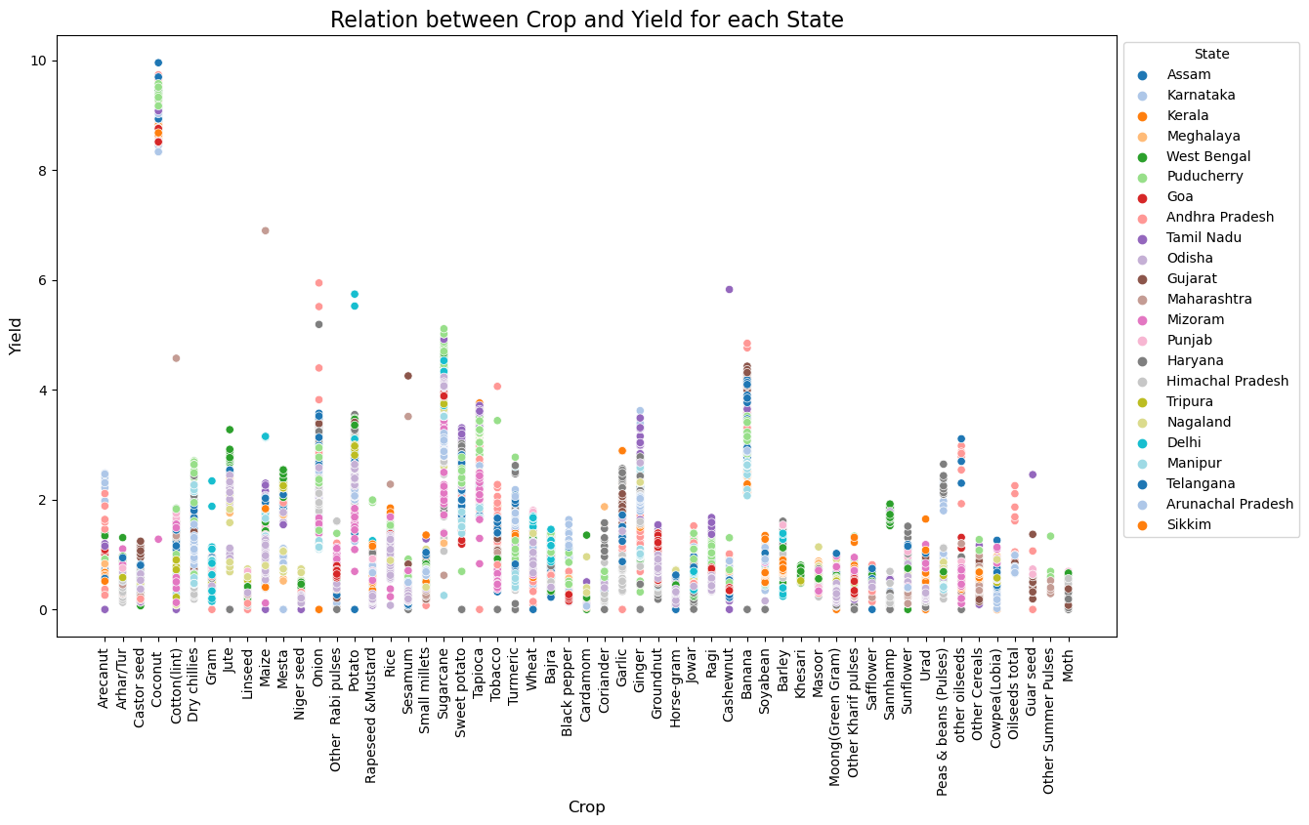
Exploratory Data Analysis
Found the relation between type of crop and their yield for each state
Output:

Slide 25
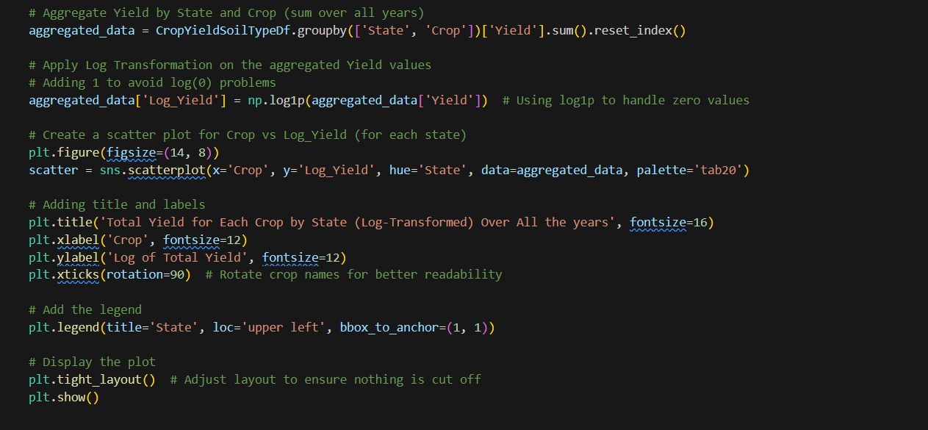
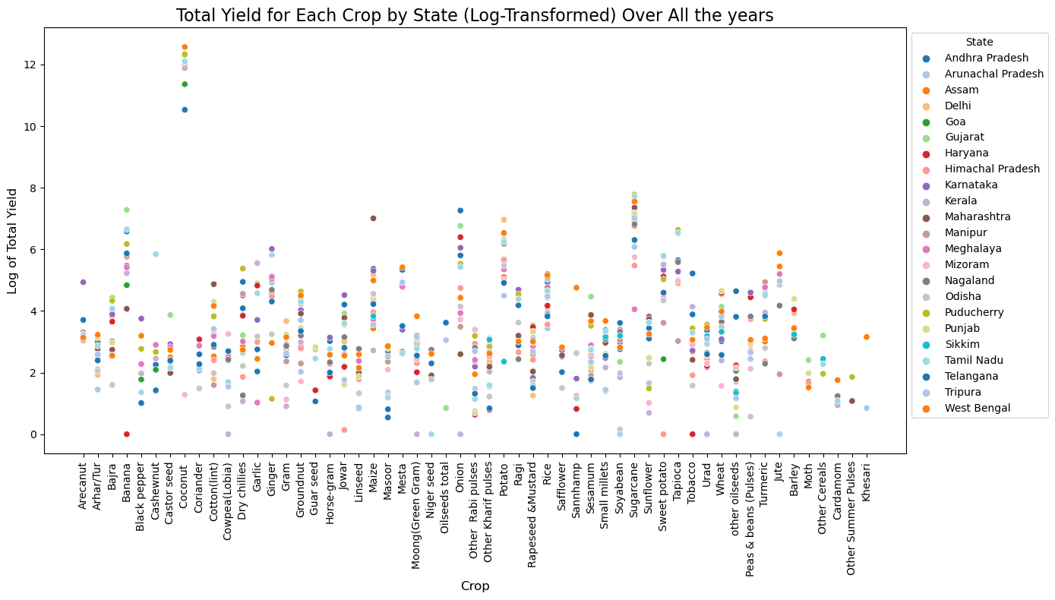
Exploratory Data Analysis
Found the Total Yield for Each Crop by State (Log-Transformed) Over All the years
Output:

Slide 26
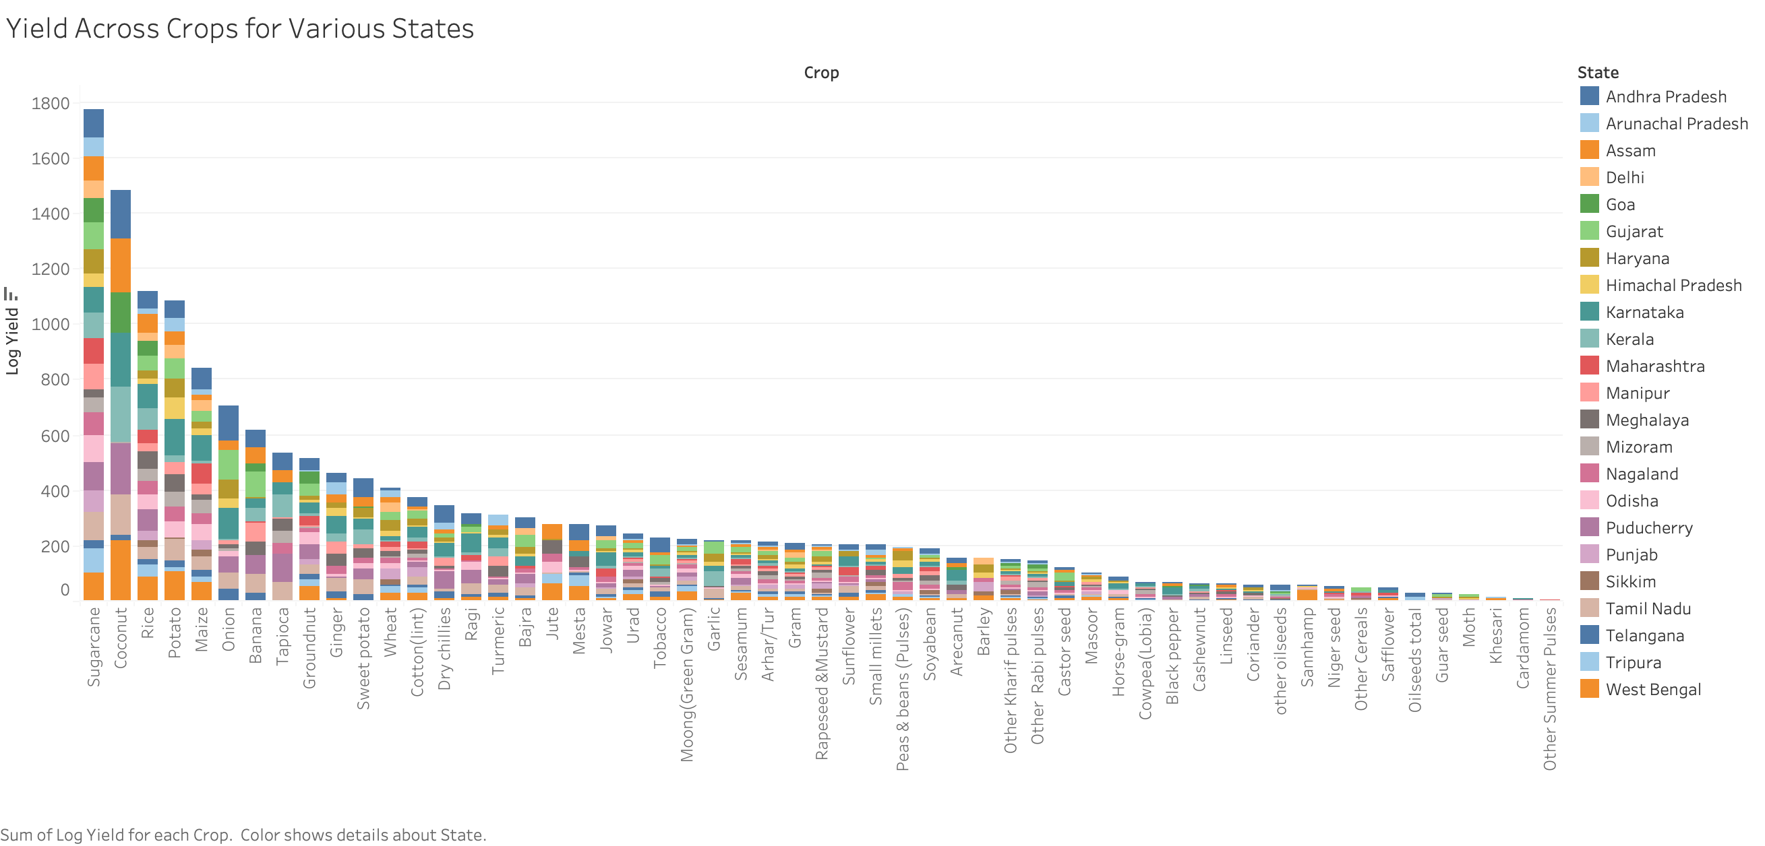
Exploratory Data Analysis

Slide 27
Machine Learning Models used
Linear Regression
Polynomial Regression
Decision Tree.
Random Forest
Support Vector Regression (SVR).
K-Nearest Neighbors
Note: Almost all the models were trained with the dataset being split into 80% of train and 20% as test data.

Slide 28

Machine Learning Models
Linear Regression: Linear Regression works by drawing a straight line that best fits the relationship between the input features and crop yield.
Polynomial Regression (degree 2): This algorithm works like linear regression, but fits a curved line instead of a straight one, allowing it to model more complex relationships.
Decision Tree Regressor: This Algorithm divides the data into smaller segments using conditions and makes predictions based on average values in each segment.
Random Forest Regressor: This algorithm uses multiple decision trees and averages their results for better accuracy and stability.
Support Vector Regressor (SVR): SVR tries to fit the best curve within a margin of tolerance which makes it great for precise predictions in non-linear data.
K-Nearest Neighbours Regressor: This algorithm predicts the yield based on the average of the closest data points (neighbours) in the dataset.

Slide 29
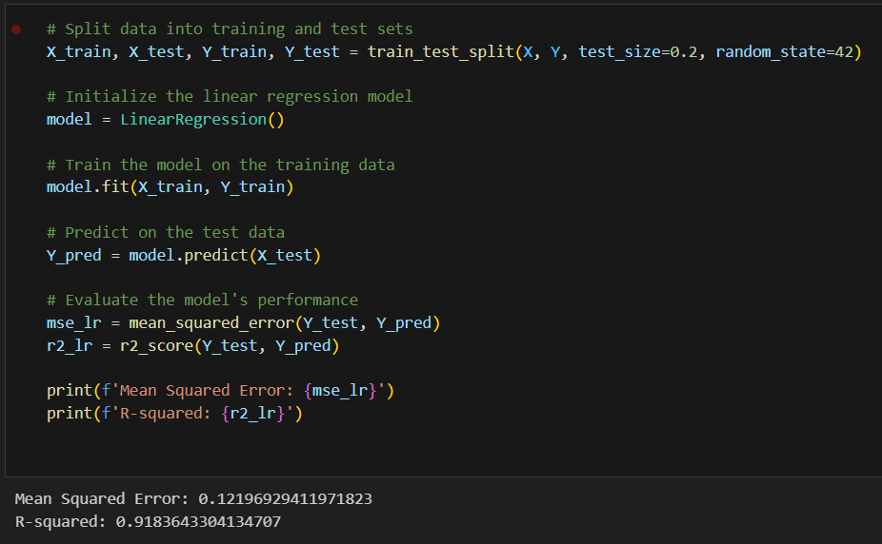
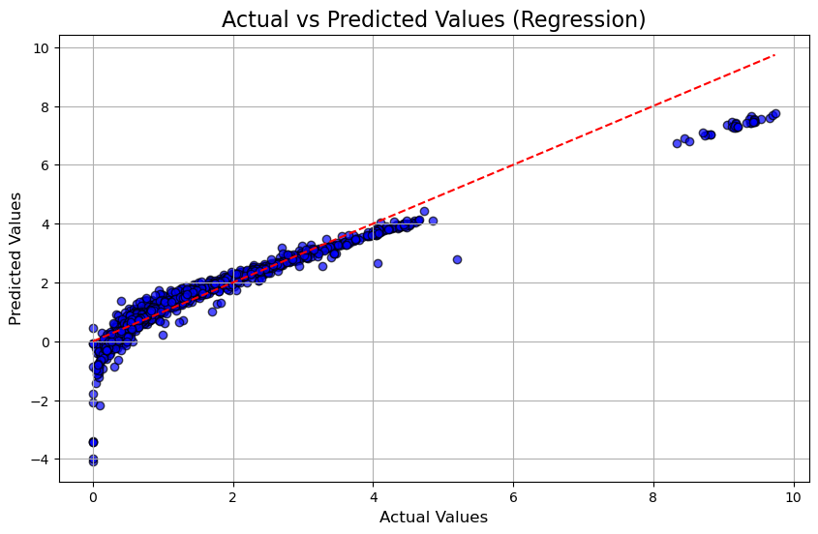
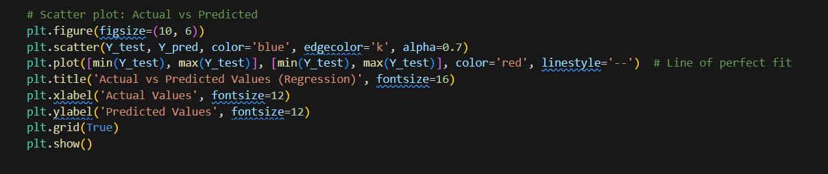
Linear Regression Trained Linear regression model and got the R-squared value of 0.9183643304134707

Slide 30
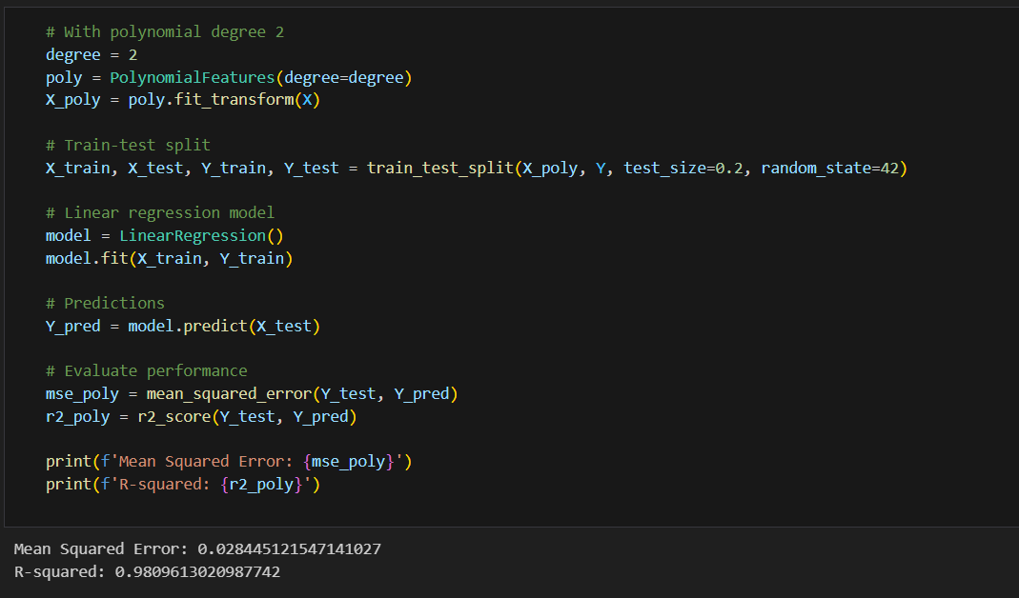
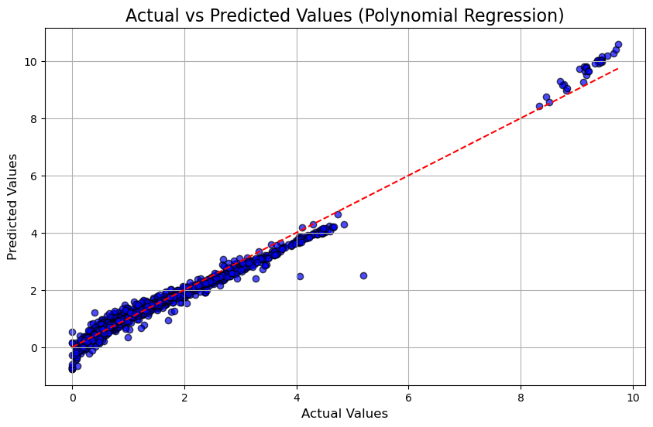
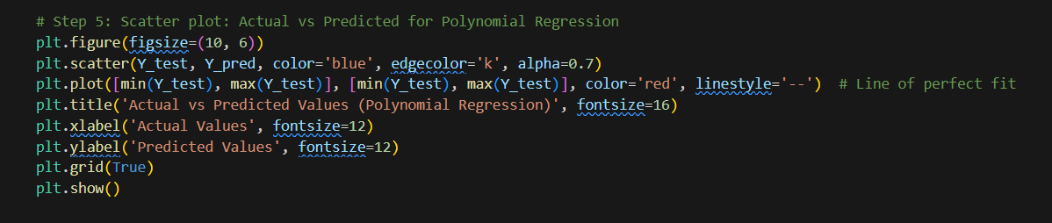
Polynomial Regression Trained Polynomial regression model and got the R-squared value of 0.9809613020987742

Slide 31
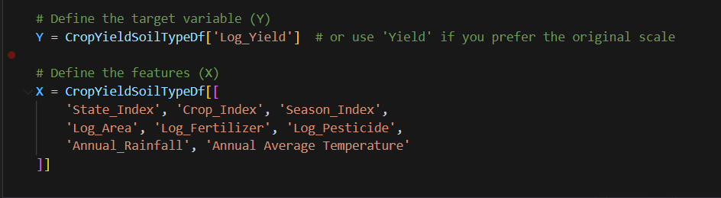
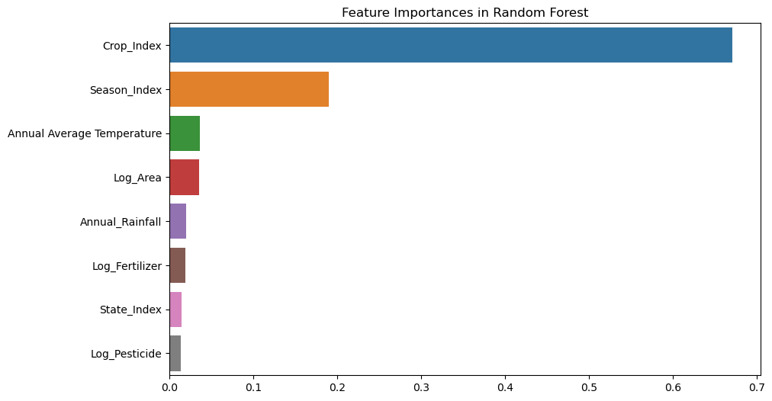
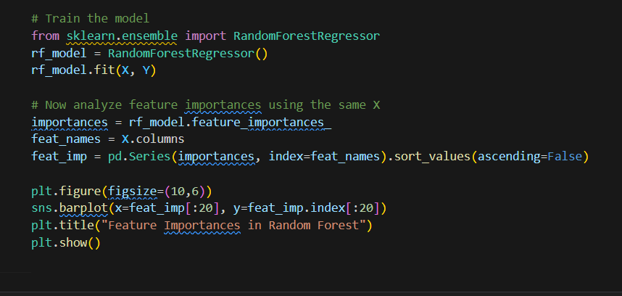
Random Forest Used Random Forest Regressor to know the Feature importance of the datset.

Slide 32
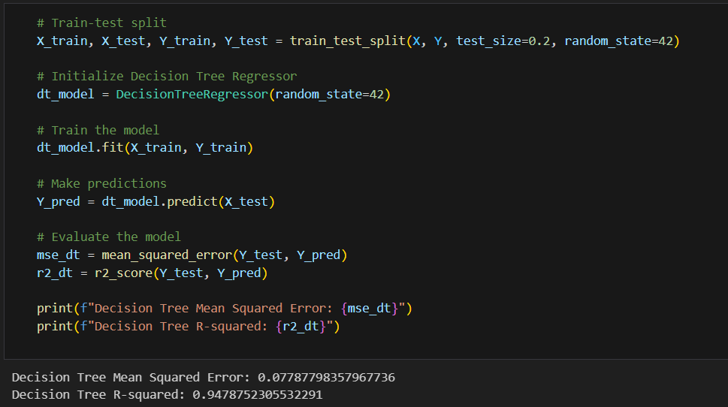
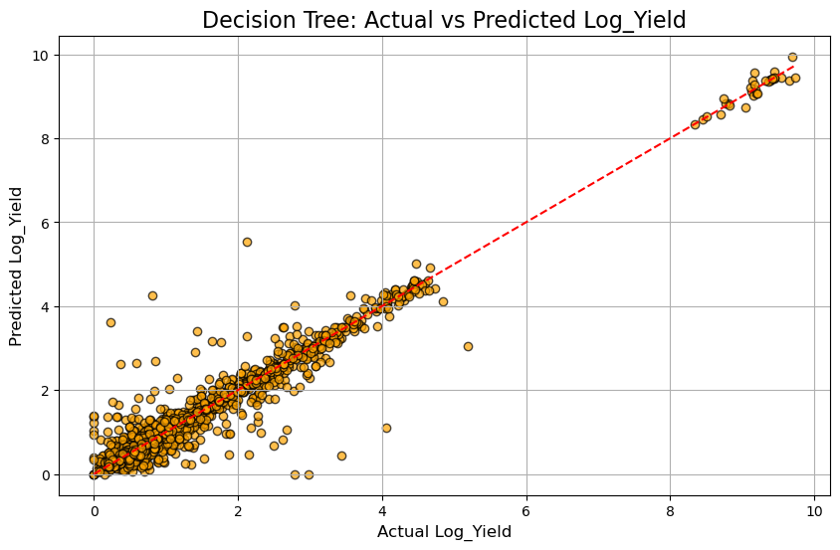
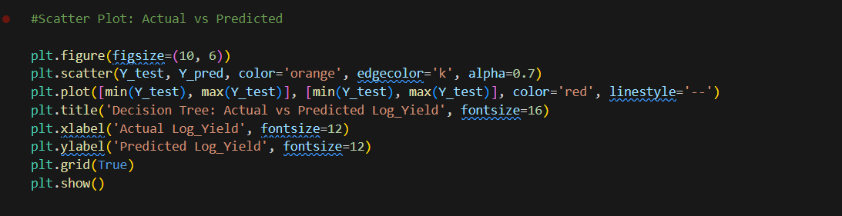
Decision Tree Trained Deecision tree regression and got the R-squared value of 0.9478752305532291

Slide 33
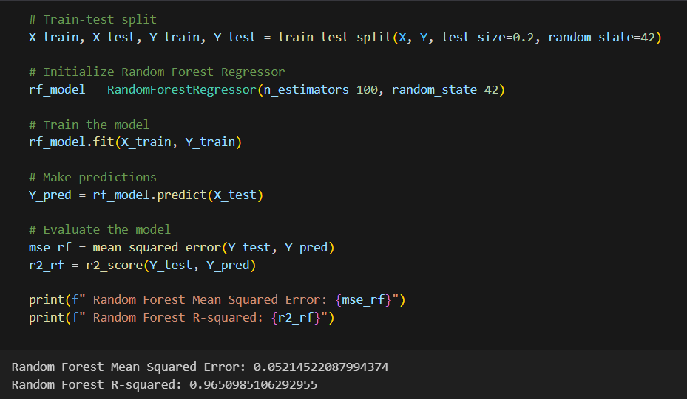
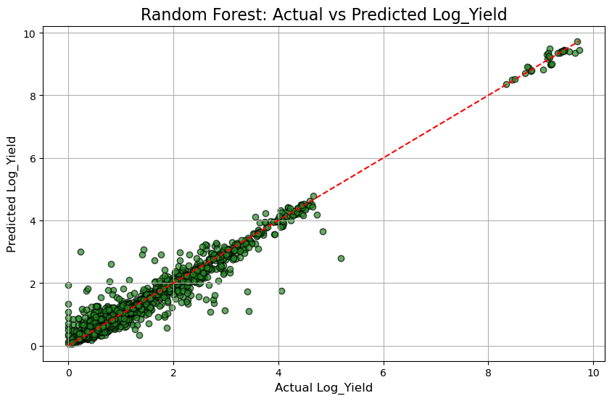
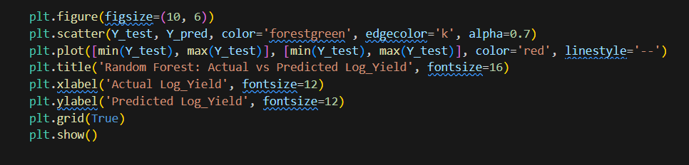
Random Forest Trained Random Forest model and got the R-squared value of 0.9650985106292955

Slide 34
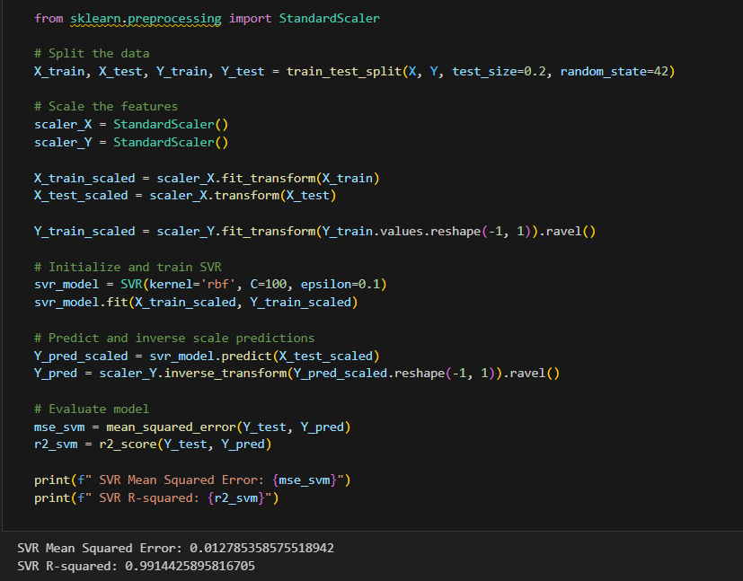
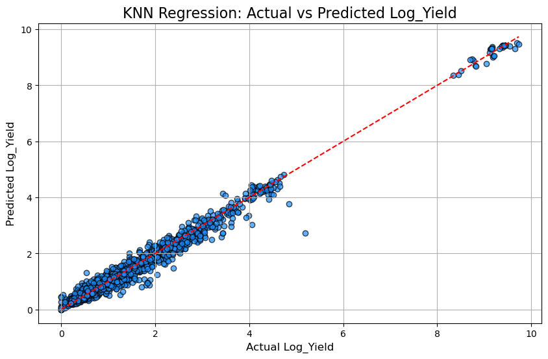
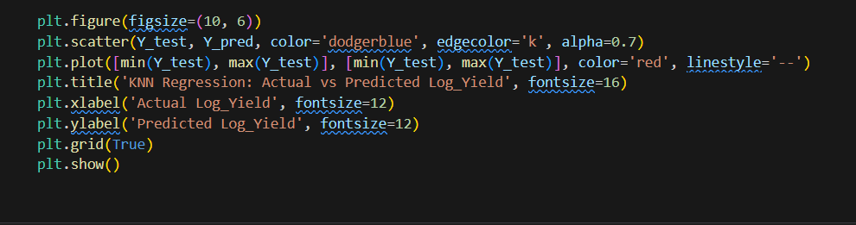
Support Vector Machine (SVM) Trained Support Vector Machine and got the R-squared value of 0.9914425895816705

Slide 35
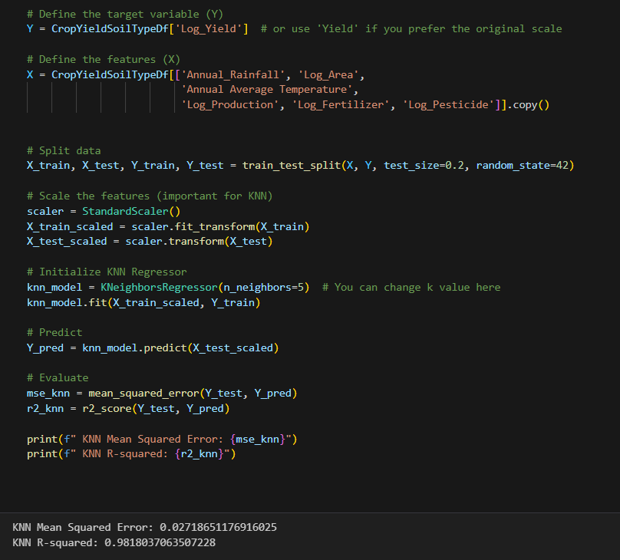
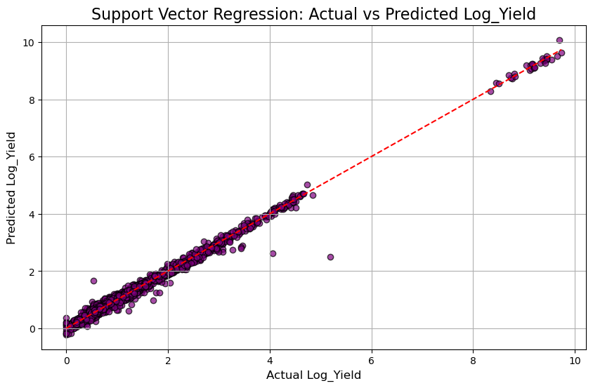
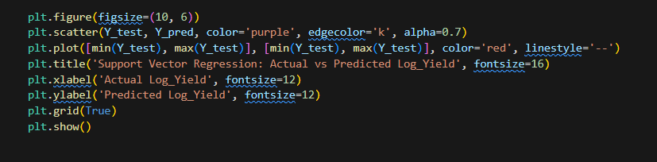
K-Nearest Neighbors (KNN) Regression Trained KNN model and got the R-squared value of 0.9818037063507228

Slide 36
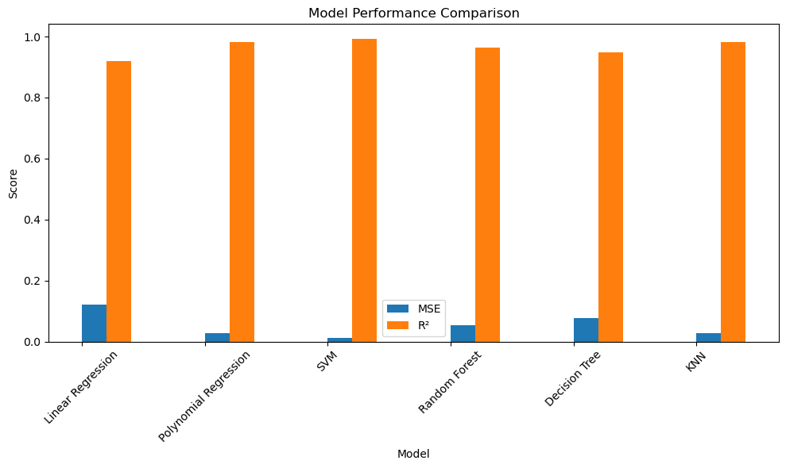
Comparison of ML Models

Slide 37
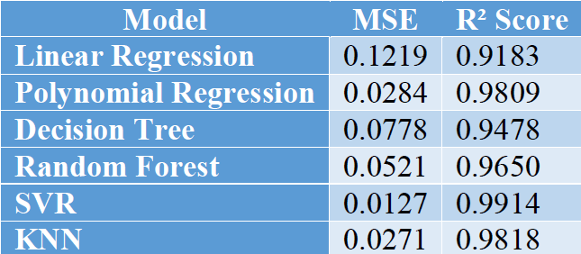
Summary of Output from ML Models
MSE (Mean Squared Error): It shows how far the predicted values are from the actual ones. A lower MSE means the model is making fewer mistakes.
R² Score (R-squared): It tells how well the model explains the variation in the data. A value closer to 1 means the model is very accurate.

Slide 38
Summary of Output from ML Models
From the outputs, we got Support vector machine as the most accurate model among all the ML models with the R-Square value of 0.991
K-Nearest Neighbour (KNN) and polynomial regression also performed well with this dataset while giving the R-Squared value of 0.981 and 0.980 respectively.
All the other ML models like Random Forest and Decision Tree didn’t perform as good as the above models while Linear Regression got the lowest R-Square value of 0.918.

Slide 39

Results
Support Vector Regression (SVR) achieved the best performance:
R² Score = 0.991
Mean Squared Error (MSE) = 0.012
Top influencing features identified: Fertilizer Use, Rainfall, Crop Type, Soil Type.
Data visualizations confirmed correlation assumptions.
Integration of historical climate data improved generalization.
Model predictions align closely with real production values.
Framework ready for future deployment with real-time input streams.
Comparative model performance visualized using line plots.
Results show promise for crop advisories and insurance forecasting.

Slide 40
Conclusion
Built accurate yield prediction model using ML and Big Data.
Feature engineering and preprocessing improved outcomes.
Climate data enhances performance for real-world deployment.
System could be linked with mobile platforms for farmer guidance.
Model extensible to real-time IoT sensor inputs in future upgrades.

Slide 41
References
Agricultural crop yield in Indian States dataset. (2023, July 17). Kaggle. https://www.kaggle.com/datasets/akshatgupta7/crop-yield-in-indian-states-dataset
Chowdhury, P. (2024, November 6). State-wise area by major soil type in India - 360 Analytika. 360 Analytika. https://360analytika.com/state-wise-area-by-major-soil-type-in-india/]
World Bank Climate Change Knowledge Portal. (n.d.). https://climateknowledgeportal.worldbank.org/country/india/climate-data-historical
K. Ramu and K. Priyadarsini, "A Review on Crop Yield prediction Using Machine Learning Methods," 2021 2nd International Conference on Smart Electronics and Communication (ICOSEC), Trichy, India, 2021, pp. 1239-1245, doi: 10.1109/ICOSEC51865.2021.9591764. https://ieeexplore.ieee.org/document/9591764

